Slide 1
Model Reconstruction from Model Explanations
Smitha Milli, Ludwig Schmidt, Anca D. Dragan, Moritz Hardt
Presented by:
Monica Ribero
Shorya Consul

Slide 2
Motivation
Tension between explainability and secrecy
Assess model behaviour and performance
Transparency
Concrete contexts need explanations
Medical diagnosis
Employment
Criminal justice
Competitive value
Diminished predictive power (easier to trick)
Protect training data
Objective
Provide theoretical and empirical evidence that first order oracles allow to recover model from explanations.

Slide 3
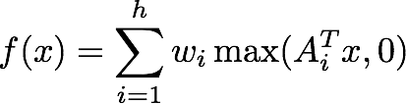

Problem formulation
Given an unknown classifier find identical to given access to:
Membership (class)
Gradient queries
Focus on a single layer NN:
Assumptions:
Rows of A are unit vectors
No two rows are collinear :
The rows of A are linearly independent

Slide 4
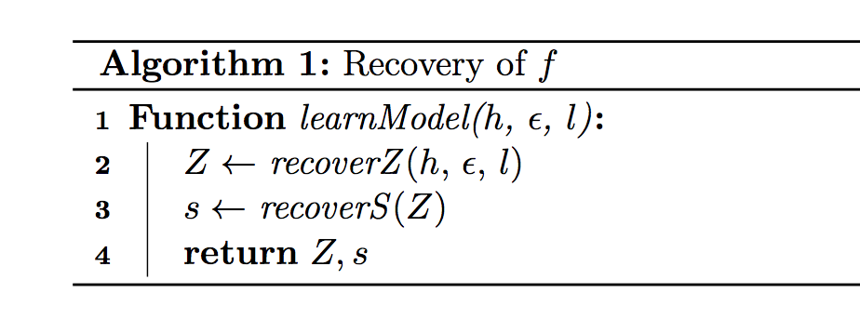
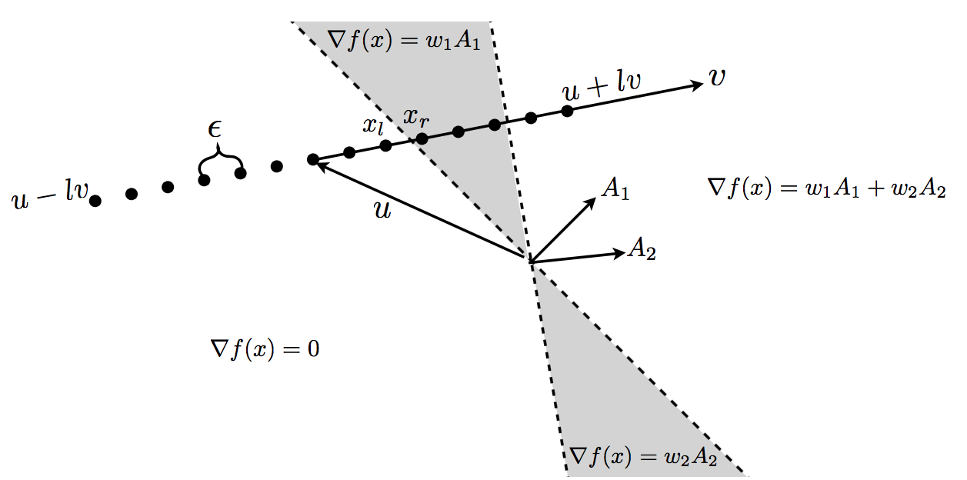
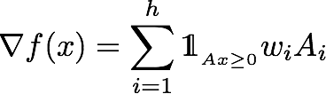
How
Algorithm 1.
IDEA
The neural network divides input space into cells
Points within same cell have same gradient
If different gradient but close → get (single) index where they differ
IT WORKS
Points at which gradient changes are spaced
Binary searh works (Lemma 1)

Slide 5
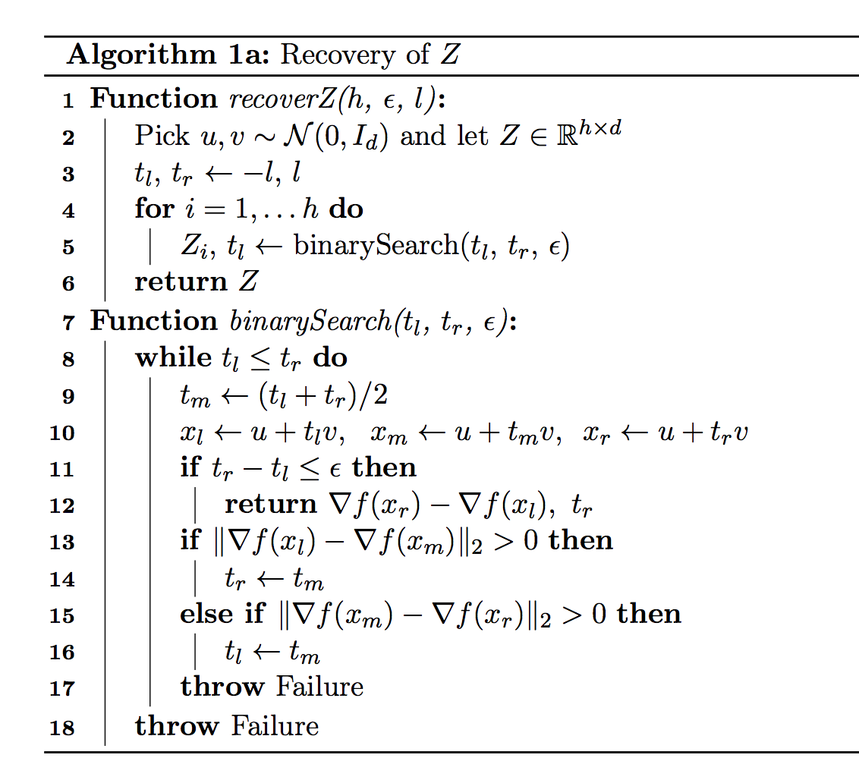

Algorithm 1
Recover Z
h
log h

Slide 6
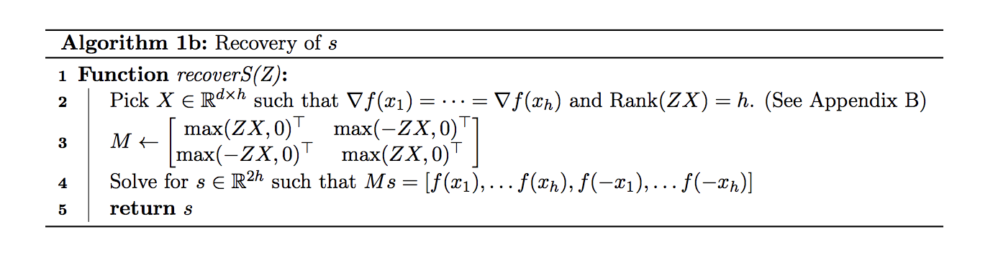
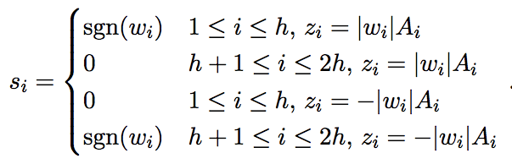

Algorithm 1
Find sign for rows of Z
i-th column of X
Linear program to find X
Full rank

Slide 7


Theorem 1
Algorithm 1a:
Algorithm 1b : sign s
With probability Algorithm 1 finds in

Slide 8
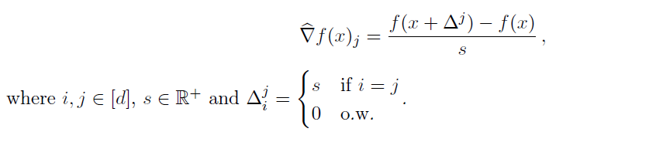
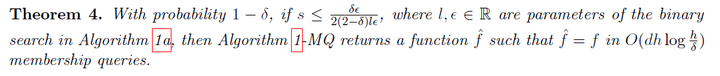
Extension:
Only using membership queries
Algorithm 1-MQ
# queries required

Slide 9
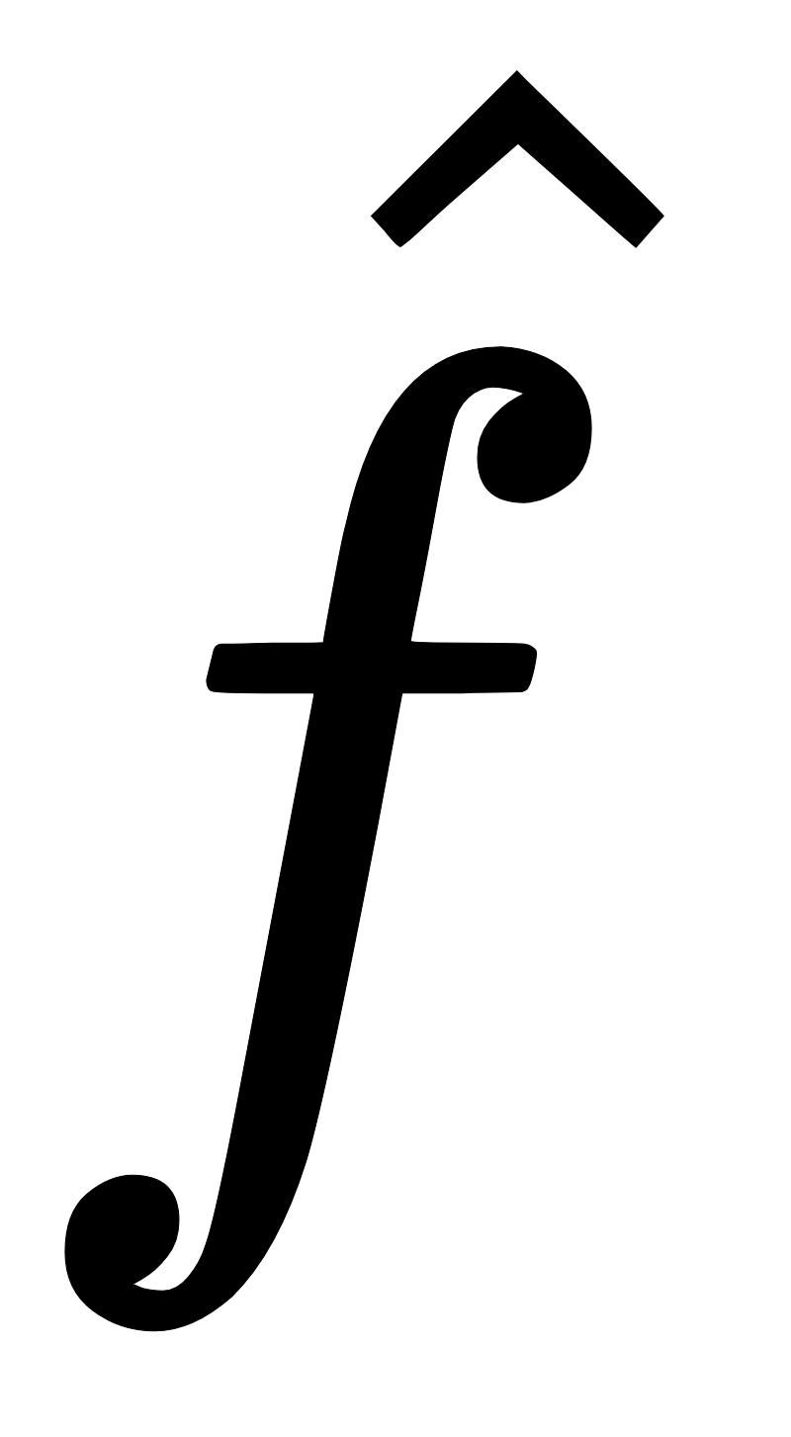
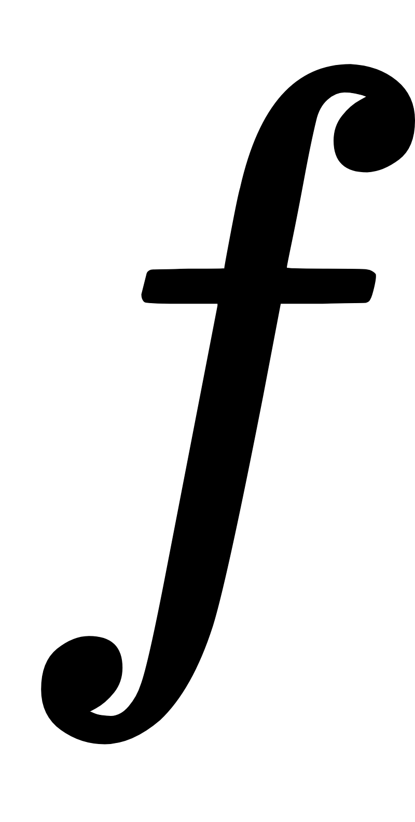


Experiments
Train a new classifier to match the output of given model
(Joint) loss function
Loss on memberships
(cross-entropy)
Loss on gradients

Slide 10
Experiments
True classifier f trained on
40,000 images from MNIST with ground-truth labels
50,000 images from CIFAR10 with ground-truth labels
Reconstructed classifier trained on 10,000 images randomly sampled from training set
Without ground-truth labels, queried from f
Test set of 10,000 images and ground-truth labels

Slide 11
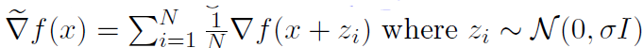
Experiments
Compare test accuracy after
Using only membership queries
Using membership + gradient queries
Same as b but gradients from SmoothGrad

Slide 12
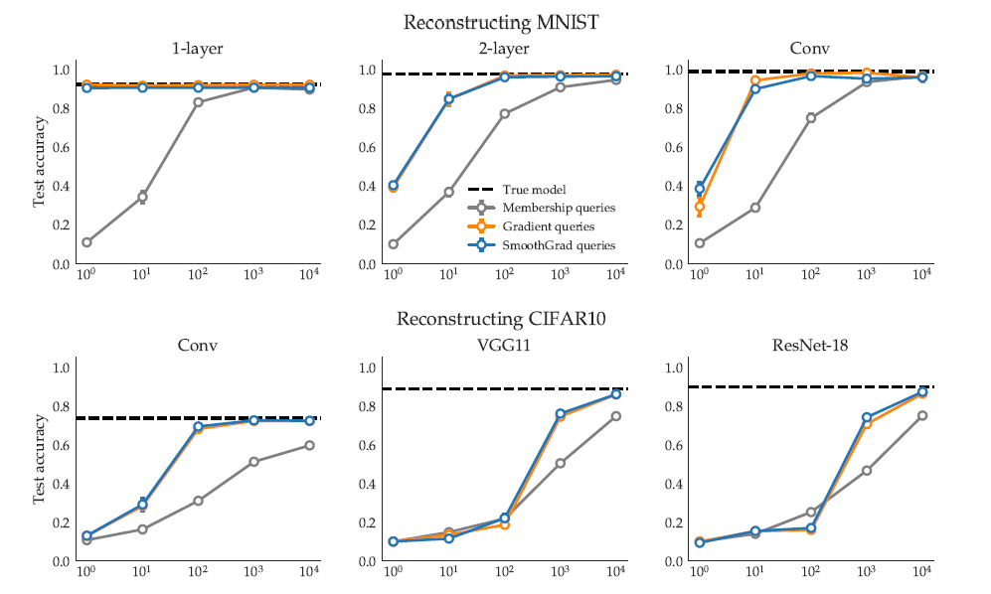
Experiments (known model + distribution)
Can uniquely identify network with 1 gradient query
Fewer membership+gradient queries required for same accuracy
Larger difference for simpler models
More queries needed more more complex task (CIFAR10)

Slide 13
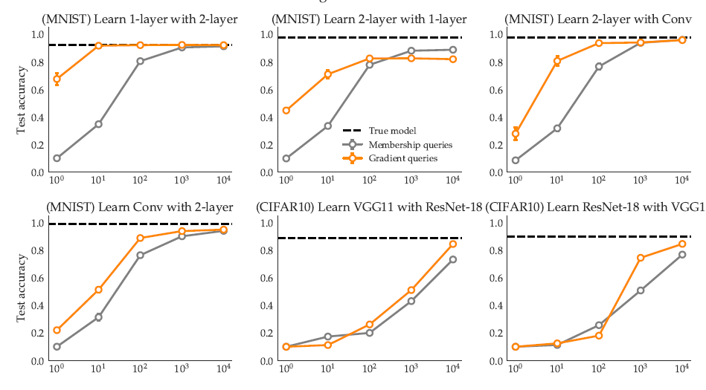
Experiments (unknown model)
Gradient queries confer more speedup when is more complex than f
ResNet-18 more complex than VGG11? (insignificant difference)

Slide 14
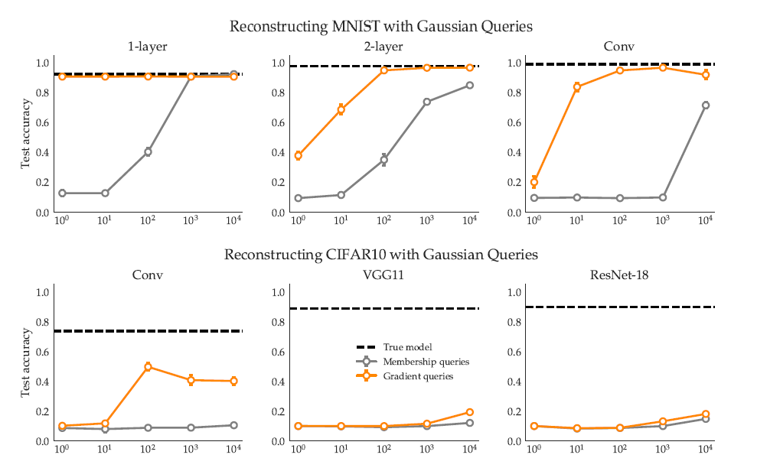
Experiments (unknown distribution)
Use randomly generated Gaussian queries
Greater speedup in MNIST (1000x vs 100x)
Speedup but performance poor using either type of queries

Slide 15
Drawbacks:
Known data distribution appears to be critical for “complex” tasks
Some knowledge of architecture, or its complexity, needed so that is “complex enough”
Hierarchy of complexity not clear, as in the case of VGG and ResNet

